Slide 1
Preparing to meet web accessibility guidelines:
Step 1…knowing
Notes:
Preparing to meet web accessibility guidelines:
Step 1…knowing

Slide 2
Tell us your context (poll)
You outsource the website design and maintenance to others.
You create and maintain the website using a third party tool or online site. You don’t do much code.
You are technically skilled and can design web sites from scratch
Other
Notes:
Your context
You outsource the website design and maintenance to others.
You create and maintain the website using a third party tool or online site. You don’t do much code.
You are technically skilled and can design web sites from scratch
Other

Slide 3
The legislation in a nutshell
Over riding principle = (i) stem the flow of new inaccessible content then (ii) tackle the legacy.
Your website hasn’t been updated since before 23 Sept 2018
In which case your website must comply by Sept 2020
2019
Website
Websites and ‘active admin’ content need to be compliant by Sept 23rd 2019
…unless
Content created after 2019 must comply but older ‘active admin’ content needs to comply by Sept 2020.
2019
Documents published before 23 Sept 2018 are not in active admin use. Exempt.
“Office” files
But
Video
Must comply by Sept 2020, whether on new or old site.
Notes:
The legislation in a nutshell:
Over riding principle = (i) stem the flow of new inaccessible content then (ii) tackle the legacy.
By 2019 - Websites and ‘active admin’ content need to be compliant by Sept 23rd 2019 except…
If your website hasn’t been updated since before 23 Sept 2018 - In which case your website must comply by Sept 2020
For “Office” files where Documents published before 23 Sept 2018 are not in active admin use. If they meet these criteria they are exempt from the regs However Content created after 2019 must comply but older ‘active admin’ content needs to comply by Sept 2020.
Video Must comply by Sept 2020, whether on new or old site.

Slide 4
Accessibility in 4 words and 1 phrase
4 words
Perceivable
Operable
Understandable
Robust
1 phrase
“Accessible to whom?”
The web is not a barrier to people with disabilities, it is the solution.
However, for the web to reach its full potential for people with disabilities, web developers must commit to always designing with accessibility in mind.
Failure to do so risks turning a revolutionary solution into yet another barrier in the lives of people with disabilities.
Adapted from https://webaim.org/articles/pour/
Notes:
Accessibility in 4 words and 1 phrase
4 words
Perceivable
Operable
Understandable
Robust
1 phrase
“Accessible to whom?”
Quote from WebAim - The web is not a barrier to people with disabilities, it is the solution.
However, for the web to reach its full potential for people with disabilities, web developers must commit to always designing with accessibility in mind.
Failure to do so risks turning a revolutionary solution into yet another barrier in the lives of people with disabilities.
Adapted from https://webaim.org/articles/pour/

Slide 5
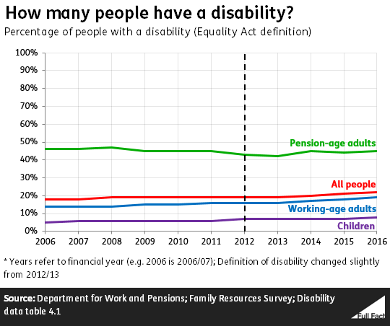
Disability prevalence
11.6 m disabled people in UK,
5.7 million adults of working age,
5.1 million over state pension age
Disability | % Working age | % pension age
Vision | 11 | 18
Hearing | 8 | 23
Mobility | 44 | 68
Dexterity | 24 | 34
Learning difficulties | 14 | 8
Memory | 16 | 17
Mental health | 32 | 9
Notes:
Disability prevalence
11.6 m disabled people in UK,
5.7 million adults of working age,
5.1 million over state pension age
11 % of working age registered disabled people have vision problems rising to 18% of pension age.
8 % of working age registered disabled people have hearing problems rising to 23% of pension age.
44 % of working age registered disabled people have mobility problems rising to 68% of pension age.
24 % of working age registered disabled people have dexterity problems rising to 34% of pension age.
14% of working age registered disabled people have Learning difficulties compared to 8% of pension age.
16% of working age registered disabled people have memory problems rising to 17% of pension age.
32 % of working age registered disabled people have mental health problems compared with 9% of pension age.

Slide 6
Disability prevalence
Implications for web based information
Disability | % Working age | % pension age | Implications for website design?
Vision | 11 | 18
Hearing | 8 | 23
Mobility | 44 | 68
Dexterity | 24 | 34
Learning difficulties | 14 | 8
Memory | 16 | 17
Mental health | 32 | 9
http://bit.ly/SLCCpart1
Notes:
What are the implications for your website?
11 % of working age registered disabled people have vision problems rising to 18% of pension age.
8 % of working age registered disabled people have hearing problems rising to 23% of pension age.
44 % of working age registered disabled people have mobility problems rising to 68% of pension age.
24 % of working age registered disabled people have dexterity problems rising to 34% of pension age.
14% of working age registered disabled people have Learning difficulties compared to 8% of pension age.
16% of working age registered disabled people have memory problems rising to 17% of pension age.
32 % of working age registered disabled people have mental health problems compared with 9% of pension age.

Slide 7
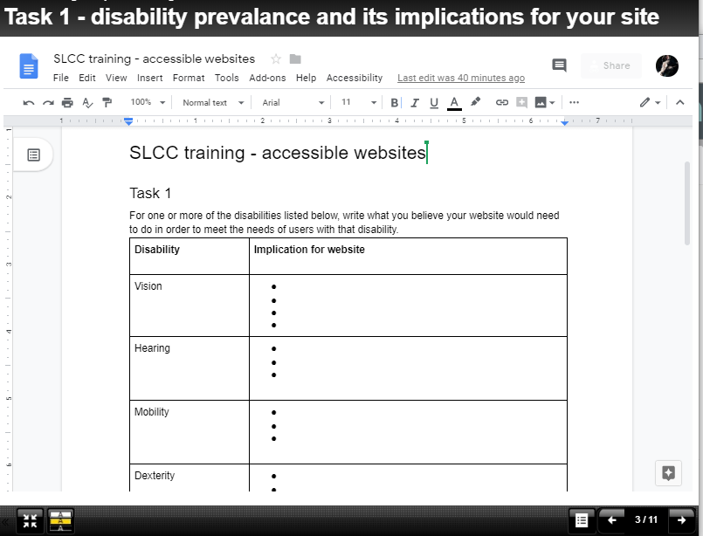
Your turn…
http://bit.ly/SLCCpart1
Notes:
Your turn – open up the accompanying resource
http://bit.ly/SLCCpart1

Slide 8
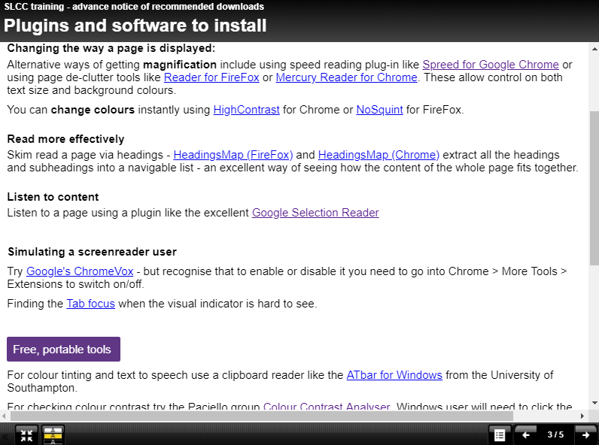
Anatomy of a user
Key “user techniques ” include:
Magnify (CTRL +)
Keyboard only navigation
Navigation by headings
Colour/contrast optimisation
Text to speech (sighted)
Screen reader (blind)
Notes:
Anatomy of a user
Key “user techniques ” include:
Magnify (CTRL +)
Keyboard only navigation
Navigation by headings
Colour/contrast optimisation
Text to speech (sighted)
Screen reader (blind)

Slide 9
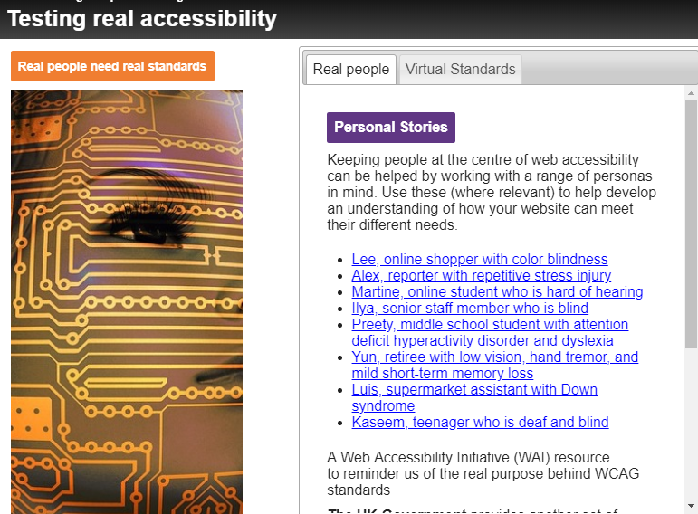
Follow up with others
Using the chat pane, suggest some characteristics for some of your users. Age? IT awareness? How they’ll access your website (phone/tablet/laptop)? Any disabilities or particular struggles?
Notes:
Follow up with others
Use ‘personas’.
User personas are available from the Web Accessibility Initiative as well as from the gov.uk website. - https://www.gov.uk/government/publications/understanding-disabilities-and-impairments-user-profiles
Developing your own based on typical users helps you look more critically and reflectively at your own practices.
Using the chat pane, suggest some characteristics for some of your users. Age? IT awareness? How they’ll access your website (phone/tablet/laptop)? Any disabilities or particular struggles?

Slide 10
Risk analysis
Harder to test
Screen readers and forms
Screen readers and text
Image descriptions
Text to speech
Works on phones
Readability
Magnification & reflow
Tab order
Heading structure
Easy to test
Colour contrast
Tab focus
Affects many in moderate way
Affects few in a major way
Notes:
Risk analysis
Risk is a mixture of likely impact and likely frequency. This diagram shows that some failings (those in bold) are bigger risks. However there is also a spectrum of ‘ease of audit’ as well as a spectrum of impact.
Disabilities like dyslexia or mild visual impairment are high incidence, you will have many such users use your website. However, accessibility failings that impact on them will not completely lock them out the website – just make it more difficult to use. Conversely, screenreader users or keyboard-only users are a lower incidence group but they can be completely locked out of the website (so very high impact) if their needs are not met.
Features that are easy to audit (and can be done without additional tools, skills or plugins) include Magnification, reflow, Tab order and visual tab focus.
Features that may require a bit more by way of a plugin, a testing tool or testing protocol include Text to speech, colour contrast, heading map plugin and readability testing.
Features that need level of skill and experience to test include Image descriptions, screenreader access to main website content and screenreader access to forms, menus and interactivities.

Slide 11
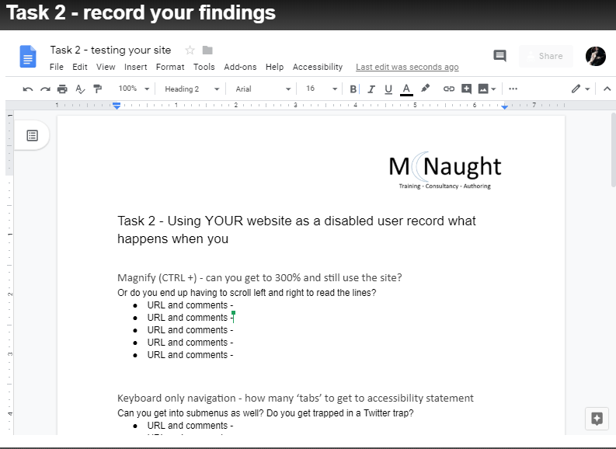
Over to you
Use Chrome or FireFox
Load your website in a new browser tab.
Work through some of the tests in the accompanying resource.
Notes:
Over to you
Use Chrome or FireFox
Load your website in a new browser tab.
Work through some of the tests in the accompanying resource.

Slide 12
Anatomy of a website - 1
Structure, navigation and live content

Slide 13
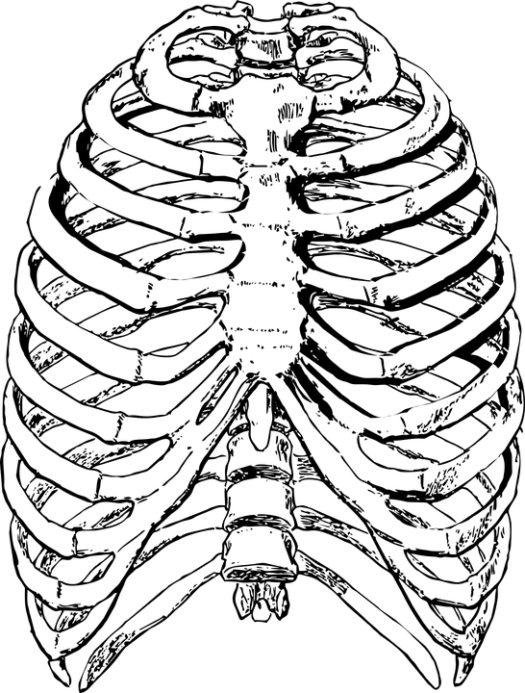
Anatomy of a website – core content
Pages
Navigation / site structure
Responsive design
Menus
Hyperlinks (meaningful)
Tab order, tab focus, skip links
Image descriptions (or marking as decorative)
Videos, controls, transcripts, subtitles
Forms and form labelling for screen readers
Downloadable content
Documents
print based forms.
Notes:
Thinking through the ‘anatomy’ or ingredients of a typical website can help make the task more manageable.
How does each of these work without a mouse? Work at high magnification? Work with an assistive technology?
Pages
Navigation / site structure
Responsive design
Menus
Hyperlinks (meaningful)
Tab order, tab focus, skip links
Image descriptions (or marking as decorative)
Videos, controls, transcripts, subtitles
Online forms and interactions.
Text readability..
Downloadable content
Documents
Print based forms.

Slide 14
Anatomy of a website - links
Version 1
To find out more about the planned digging up of the village pavements click here. The disruption will also affect phone lines. If you are disabled or housebound click here for alternative safety arrangements.
Version 2
To find out more about the planned digging up of the village pavements click here. The disruption will also affect phone lines. If you are disabled or housebound click here for alternative safety arrangements.
Sounds like
click here
click here
Sounds like
planned digging up of the village
alternative safety arrangements
Notes:
Anatomy of a website – links
It’s important that every hyperlink should have unique and meaningful link text, not just “Click kere”
Version 1
To find out more about the planned digging up of the village pavements click here. The disruption will also affect phone lines. If you are disabled or housebound click here for alternative safety arrangements.
Version 2
To find out more about the planned digging up of the village pavements click here. The disruption will also affect phone lines. If you are disabled or housebound click here for alternative safety arrangements.

Slide 15
Anatomy of a website - 2
Content for downloading – PDF, Word etc.

Slide 16
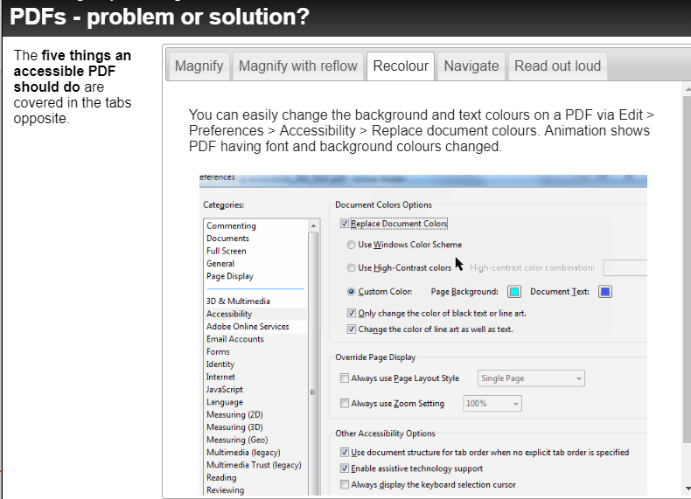
Anatomy of a website – PDFs and Word
Either
Explore the tabs on “five things a PDF document should be able to do.
Find a PDF on your website. Save it to the desktop. Open in Adobe Reader. How does it do?
Or
Find a video and see if you can control it without a mouse. Does it have a transcript or subtitles?
Or
Check if you can find any ‘click here’ or ‘here’ links that need changing.
Or
Check the readability of your content – either online or downloadable.
Notes:
Anatomy of a website
Either
Explore the tabs on “five things a PDF document should be able to do.
Find a PDF on your website. Save it to the desktop. Open in Adobe Reader. How does it do?
Or
Find a video and see if you can control it without a mouse. Does it have a transcript or subtitles?
Or
Check if you can find any ‘click here’ or ‘here’ links that need changing.
Or
Check the readability of your content – either online or downloadable.
- content

Slide 17
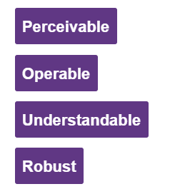
Legislation revisited
Are you failing to make a reasonable adjustment?
Under the new legislation you need to
Ensure your website meets accessibility standards and
Publish a detailed accessibility statement based on the Government's model template - we'll explore this next session.
You have until either Sept 2019 or Sept 2020 to comply, depending on whether your website is new or substantially changed since Sept 2018.
Stem the "inaccessible" flow
Budget for testing
Involve others
Notes:
Legislation revisited
Are you failing to make a reasonable adjustment?
Under the new legislation you need to
Ensure your website meets accessibility standards and
Publish a detailed accessibility statement based on the Government's model template - we'll explore this next session.
You have until either Sept 2019 or Sept 2020 to comply, depending on whether your website is new or substantially changed since Sept 2018.
Stem the "inaccessible" flow
Budget for testing
Involve others

Slide 18
Assessing priorities
Context 1:
You outsource the website design and maintenance to others.
Is website accessibility in the contract or in your procurement processes?
Which accessibility standards do your suppliers currently meet?
Which standards do they know they don’t yet meet?
Is there an existing accessibility statement?
How can they help you meet your obligation (or who else would be able to)?
Notes:
Assessing priorities
Tackling the issues will depend on your context and the nature of you ‘power and control’! Here’s the first of three contexts you might be working in …
Context 1:
You outsource the website design and maintenance to others.
Is website accessibility in the contract or in your procurement processes?
Which accessibility standards do your suppliers currently meet?
Which standards do they know they don’t yet meet?
Is there an existing accessibility statement?
How can they help you meet your obligation (or who else would be able to)?

Slide 19
Assessing priorities
Context 2:
You create and maintain the website using a third party tool or online site. You don’t do much code.
Do you know the accessibility credentials of the tool/site you use? Can you find out?
Which of the following good practices do you follow on web content AND downloadable resources?
Checking colour contrasts (including the contrast on followed links)
Using heading styles for navigation,
Using meaningful, unique hyperlink text,
Describing images or (marking them as decorative)
Checking readability.
Notes:
Assessing priorities
Context 2:
You create and maintain the website using a third party tool or online site. You don’t do much code.
Do you know the accessibility credentials of the tool/site you use? Can you find out?
Which of the following good practices do you follow on web content AND downloadable resources?
Checking colour contrasts (including the contrast on followed links)
Using heading styles for navigation,
Using meaningful, unique hyperlink text,
Describing images or (marking them as decorative)
Checking readability.

Slide 20
Assessing priorities
Context 3:
You are technically skilled and can design web sites from scratch
Do you develop content to the web accessibility guidelines?
Do you exercise any quality control over content, including the following?
Checking colour contrasts (including the contrast on followed links)
Using heading styles for navigation,
Using meaningful, unique hyperlink text,
Describing images or (marking them as decorative)
Checking readability.
Do you know what your priorities will be now?
Notes:
Assessing priorities
Context 3:
You are technically skilled and can design web sites from scratch
Do you develop content to the web accessibility guidelines?
Do you exercise any quality control over content, including the following?
Checking colour contrasts (including the contrast on followed links)
Using heading styles for navigation,
Using meaningful, unique hyperlink text,
Describing images or (marking them as decorative)
Checking readability.
Do you know what your priorities will be now?

Slide 21
Task - 3
In the chat pane, thinking about your context, identify
What you can influence,
How you might influence it,
Where you might get extra support,
What your priorities might be.
Notes:
Task 3:
In the chat pane, describe which context best fits you and
What you can influences,
How you might influence it,
Where you might get extra support,
What your priorities might be.

Slide 22
Action planning
Please add into the chat pane your intended actions as a result of this session:
Practical – things you can do on your own
Policy – things that require input, support or agreement from other people.
Dissemination – do you have other contacts in your networks who would benefit from coming to one of these sessions?
Notes:
Action planning
Please add into the chat pane your intended actions as a result of this session:
Practical – things you can do on your own
Policy – things that require input, support or agreement from other people.
Dissemination – do you have other contacts in your networks who would benefit from coming to one of these sessions?

Slide 23
Part 2 – Accessibility statements
Using the content of this session to
Start to write an accessibility statement that includes
Benefits to users
Issues and remedies
Getting the processes in place
Technical and testing
Action planning
Notes:
Part 2 – Accessibility statements
Using the content of this session to
Start to write an accessibility statement that includes
Benefits to users
Issues and remedies
Getting the processes in place
Technical and testing
Action planning

