Slide 1
Police and Local Councils
Insp Pete Dommett
Peter.dommett@sussex.pnn.police.uk

Slide 2
Fortifying your Neighbourhood

Slide 3
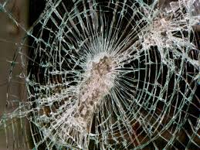
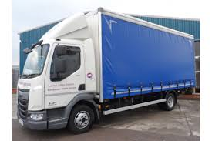
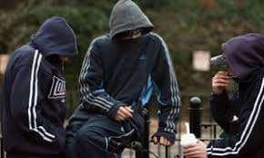
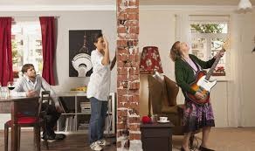
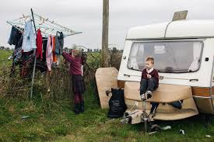
Concerns

Slide 4
Practical Actions
NHW – CCTV- Support for victims-Lead the Change
Community Speed Watch
Village Audits
Know your neighbours
Get out and about – walk not drive – been seen and deter
Talk to people
Events – organise them and let us know.

Slide 5
Social media
We cant see it all
We cant respond to it all
Some is FAKE
Encourage reporting
Avoid arguments
#Sussexpolice @sussexpolice

Slide 6
Questions

